Slide 1
CST-250 FINAL PROJECT
GROUP # 6
SORTING ALGORITHMS
Rudi Wever Jeremy Hoyle Michael Camp
Fall 2015

Slide 2
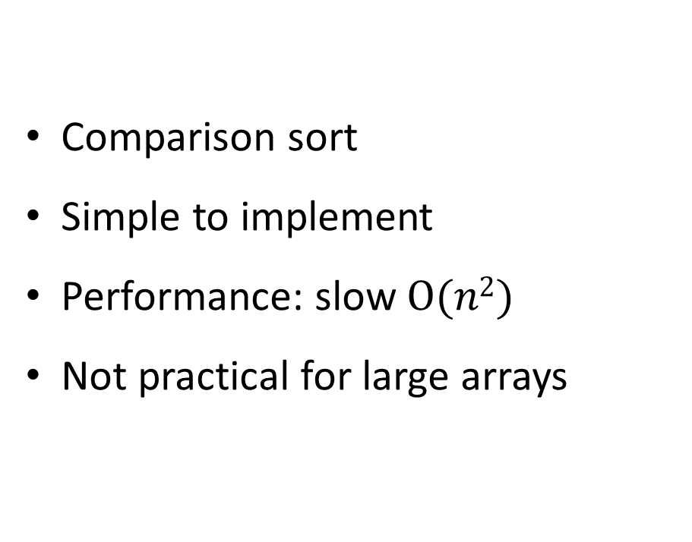
Bubble Sort:
Comparison sort
Simple to implement
Performance: slow $O(n2)$
Not practical for large arrays

Slide 3
Bubble Sort:
How it works:
Compare adjacent elements
Swap elements if they are not in relative order
Set n to index of the last swap
If no swap was performed, then list is sorted
Repeat from the beginning until n^{th} element

Slide 4
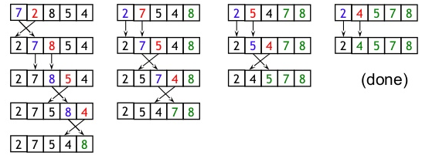
Bubble Sort:
Example:

Slide 5

Bubble Sort:
Pseudo-code:
Given a array of values of length $n$. Compare adjacent elements
swapped = false
for i = 1 to n – 1, inclusive do:
if A [ i ] > A [ i + 1]
Swap elements if they are not in relative order.
swap ( A [ i ] , A [ i + 1 ] )
swapped = true
n = i
end if
end for

Slide 6
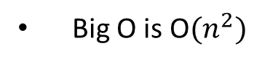
Insertion Sort:
How it works:
Similar to how we sort a deck of cards by hand
Iterates through values
Removes one element from input data
Finds correct location of input data within the sorted list
Repeats until no inputs remain
Notes:
Is efficient at sorting a small number of values
Big O is O${(n}^{2})$
Shares the same complexity with bubble sort, but is
over twice as efficient

Slide 7
Insertion Sort:
Example:
3 7 4 9 5 2 6 1
3 7 4 9 5 2 6 1
3 7 4 9 5 2 6 1
3 4 7 9 5 2 6 1
3 4 7 9 5 2 6 1
3 4 5 7 9 2 6 1
2 3 4 5 7 9 6 1
2 3 4 5 6 7 9 1
1 2 3 4 5 6 7 9

Slide 8
Insertion Sort:
Pseudo-code:
for i = 1 to length(A) – 1
x = A[i]
j = I
while j > 0 and A[j-1] > x
A[j] = A[j-1]
j = j - 1
end while
A[j] = x
end for

Slide 9
Insertion Sort:
6 Main Parts to Code Structure:
An initialize section at the top
An outer loop that handled the overall count and movement through the values
A section that moved the pointer and checked if a number needed to be switched
A section that switched the number
A section that ended the switch
A section consisting of only the return command once the algorithm was finished

Slide 10
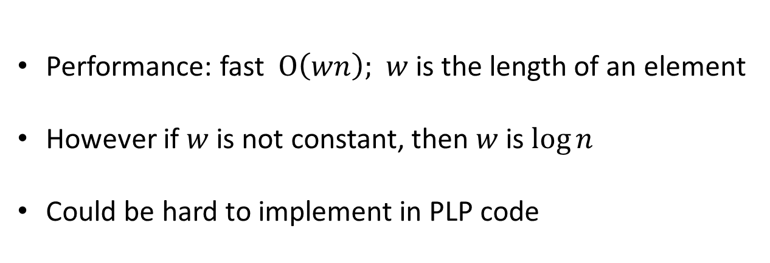
WILDCARD SORT: DIFFERENT SORTS CONSIDERED
Radix Sort
Performance: fast $O\left(wn\right);$ $w$is the length of an element
However if $w$is not constant, then $w$is $\log{n}$
Could be hard to implement in PLP code

Slide 11
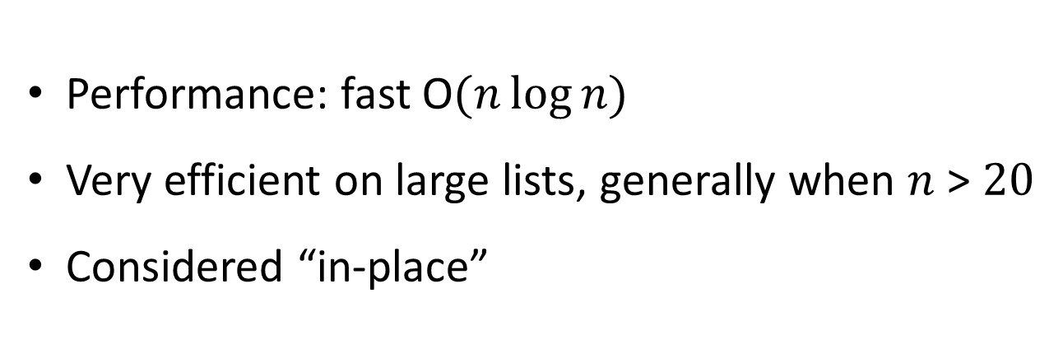
WILDCARD SORT: DIFFERENT SORTS CONSIDERED
Quick Sort
Works with a divide and conquer method
Performance: fast O$(n\log{n})$
Very efficient on large lists, generally when $n$ > $20$
Considered “in-place”

Slide 12
Quick Sort:
How it works:
Pick a ‘pivot’ value, which divides the array into 2 parts, a & b
All the elements less than the ‘pivot’ go into part a
All the elements greater than the ‘pivot’ go into part b
The routine is recursively called to sort each part, until parts
contain 1 element
The array is considered sorted

Slide 13
Quick Sort:
Pseudo-code:
Pick a ‘pivot’ value, which divides the array into 2 parts, a & b
pivot = array[(left + right) / 2]
All the elements less than the ‘pivot’ go into part a
All the elements greater than the ‘pivot’ go into part b
while (i <= j) {
while (arr[i] < pivot)
i++
while (arr[j] > pivot)
j--
if (i <= j) {
tmp = arr[i]
arr[i] = arr[j]
arr[j] = tmp
i++
j--

Slide 14
Quick Sort:
Pseudo-code:
The routine is recursively called to sort each part, until parts
contain 1 element
if (left < j)
quicksort(arr, left, j)
if (i < right)
quicksort(arr, i, right)
The array is considered sorted

Slide 15
Optimization
Code was optimized by examining all 3 algorithms for better methods
For example:
Bubble sort: after one pass, the largest value is in the n position in array.
The next pass only has to compare from array [ i ] to array [ n – 1 ] .
Insertion sort: originally implemented a register for comparison to exit, and fixed with reversing
the comparison and comparing with $0, instead of using additional registers.
Quick sort: originally had implemented a ‘middle-of-three’ method for determining
pivot location, but due to length of code, it was abandoned. Also methods for determining
arrays of size = 1 and size = 2, were deemed to take too much time for small improvements.
Initial flow path was design with jumping instead of nesting by jal instructions and caused
no recursion which worked on some cases. push and pop instructions were utilized to make
truly recursive. Additionally, branching to a jump was consolidated to a single branch
instruction for cleaner loop exits.

Slide 16
Optimization
Code was optimized for all 3 sorts by examining PLP code for faster performance
For example:
In the case where a register needs
to be initialized to a value of 0 or 1,
li $t1, 0
li $t2, 1
this can be performed faster by,
lui $t1, 0
ori $t2, $0, 1
For example:
In some instances, nop instructions were removed or replaced by instructions that would normally precede a jump instruction,
addu $t0, $t1, 1
j label
nop
can be performed faster by,
jump label
addu $t0, $t1, 1
This is very risky because without the branch
delay slot, the following instruction will execute, and
is not considered proper use.

Slide 17
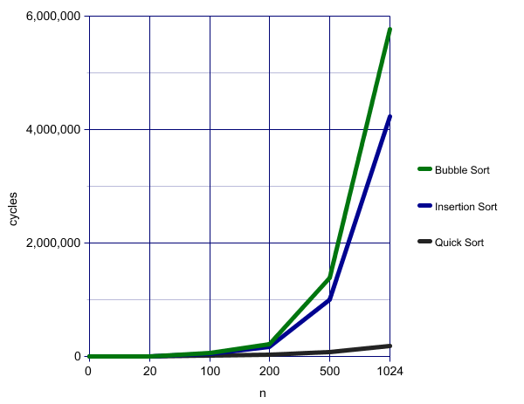
Comparison of Algorithms

Slide 18

CST-250 FINAL PROJECT
GROUP # 6
SORTING ALGORITHMS
MEMBERS
Rudi Wever
Jeremy Hoyle
Michael Camp
Fall 2015

